Slide 1
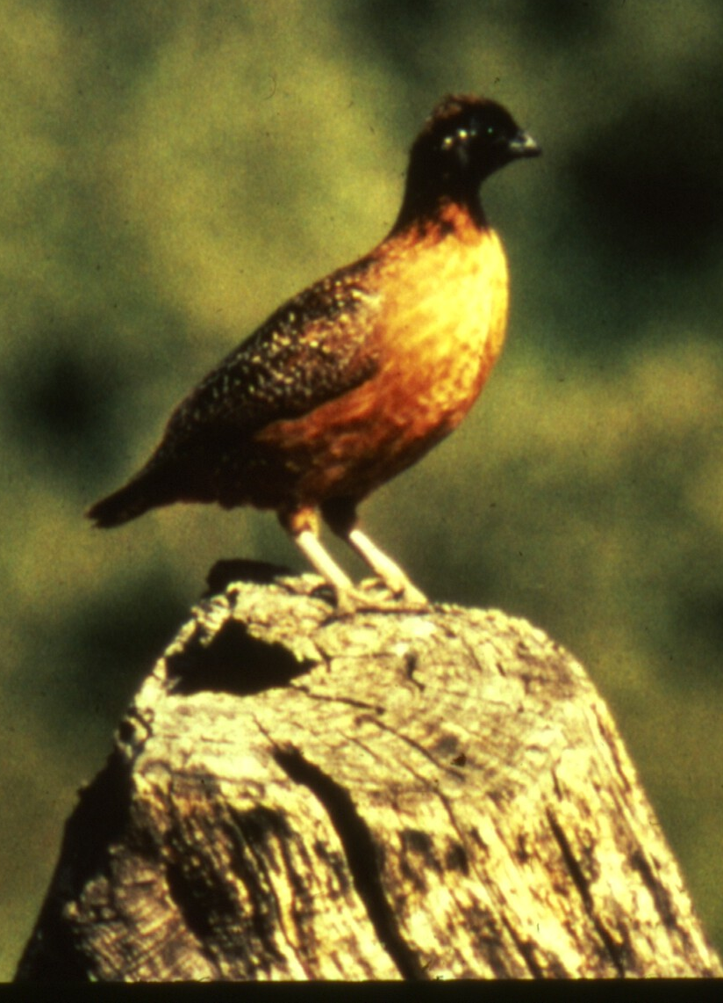
Developing a habitat suitability index model for masked bobwhite; Project Update
Dominic D LaRoche¹ and Courtney J Conway²
¹ University of Arizona, School of Natural Resources
² USGS Idaho Cooperative Fish and Wildlife Research Unit
Photo by Roy Tomlinson

Slide 2
Habitat Suitability Index Models (HSI)
Developed by the USFWS in 1981 to better evaluate fish and wildlife habitat needs
Contain quantitative relationships between key environmental variables and habitat suitability
Typically reference numerous literature sources and consolidate information
Typically used as hypotheses of species-habitat relationships
Serve as a basis for improved decision making
Increase understanding of habitat relationships through testing and refinement
Can be used to generate maps of ranked habitat units

Slide 3
Application to Masked Bobwhite
A habitat suitability model could be very valuable for masked bobwhite recovery
Can inform the search for existing masked bobwhite populations
Can help identify the best places to release captive bred bobwhites
Can inform land management decisions
Notes:
Change ‘will be’ to ‘could be’

Slide 4
Masked Bobwhite Literature
Early descriptive papers
Reviewed and described by Roy Tomlinson(1972)
General description of the species and range
Description of the habitat but little quantification
Some description of the diet
Captive Breeding and Release Papers
Not focused on habitat issues

Slide 5
Masked Bobwhite Literature
Habitat Use Papers
Restricted to a small number of variables
Woody Vegetation (Guthery et al. 2000, 2001; Ellis et al. 1993)
Bare Ground (Guthery et al. 2000, 2001)
Cover (Guthery et al. 2000, 2001)
Temperature (Guthery et al. 2000, 2001)
Herbaceous Vegetation (Guthery et al. 2000, 2001)
Invasive species (Kuvleski 2001)
Do not incorporate seasonal differences in habitat needs
Typically focused on the breeding season
Based on small samples in questionable habitat
Northern Bobwhite Papers
Not necessarily applicable to masked bobwhites
Notes:
Add year for Ellis et al.

Slide 6
Expert Opinion
Expert opinion has been used to develop models for many species
Best used for species where data is limited (Pearce et al. 2001)
Frequently used for habitat suitability models (Johnson and Gillingham 2004)

Slide 7
Project Goals
Interview species experts to determine important habitat features
Quantify the relationships between important habitat features and habitat suitability for masked bobwhite
Translate the various bivariate relationships between habitat features and masked bobwhite into a suite of mathematical habitat suitability models
Notes:
Stress why we need to get to step 2.

Slide 8
Project Goal #1 Important Variables
Habitat Variable | Rank | Weight⁻¹
Climate | 1 | -2.166667
Leguminous Shrubs | 2 | 2.25
Thermal Refugia | 3 | 2.5
Winter Food | 4 | 2.75
Herbaceous Species Diversity | 5 | 3
Woodland /Grassland Edges | 6 | 3.5
Vegetation Structural Diversity | 7 | 3.5
Brush and Shrub Cover | 8 | 3.666667
Bare Ground | 9 | 4
Grass Cover | 10 | 4
Tree Cover | 11 | 4
Avian Predators | 12 | -4.333333
Forb Cover | 13 | 4.333333
Mammalian Predators | 14 | -4.666667
Arthropod Diversity and Abundance | 15 | 5
Invasive Plant spp | 16 | 6.5
Vegetation Height (herbaceous) | 17 | 9

Slide 9
Variables to Models
How do we get from a list of important variables to functional habitat suitability models?

Slide 10
Variables to Models
How do we get from a list of important variables to functional habitat suitability models?
Focus on measurable variables

Slide 11
Variables to Models
How do we get from a list of important variables to functional habitat suitability models?
Focus on measurable variables
Measurable variables should be able to address all of the critical life history requirements of masked bobwhite:
Reproduction
Food
Thermal refuge
Predator Protection
Notes:
Change masked bobwhite quail to just ‘masked bobwhite’
Change “e.g.” to “:”

Slide 12
Measurable Variables
Habitat Variable | Rank | Weight⁻¹
Shrub Cover | 1 | 2.25
Forb Diversity | 2 | 3
Grass Diversity | 3 | 3
Woodland /Grassland Edges | 4 | 3.5
Vegetation Structural Diversity | 5 | 3.5
Bare Ground | 6 | 4
Grass Cover | 7 | 4
Tree Cover | 8 | 4
Forb Cover | 9 | 4.333333
Brush Piles | 10 | ?
Grass Height | 11 | 9
Shrub Height | 12 | ?
Forb Height | 13 | ?
Leaf Litter | ? | ?

Slide 13
Model Development
We have developed a separate model for each expert
Each model consists of 4 parts:
Measurable variables (the same for all experts)
Measured variable (can vary by expert)
Critical Habitat Components (can vary by expert)
Habitat suitability index (the result)
Measurable Variable
Measured Variable 1
Critical Habitat Component 1
Critical Habitat Component 2
Measured Variable 2
Critical Habitat Component 3
Habitat Suitability Index
Notes:
Can you change “are developing” to “have developed” ??

Slide 14
Suitability Equations: How to Measure?
The same variable may be measured in multiple ways or times depending on which latent variable equation it is included in. This allows incorporation of seasonal differences within a single model.
For example “Forb Height”
Measured in Fall -> Predator Protection, Reproduction
Measured in Spring/ Summer -> Food
Another example “Tree Cover”
Different values are optimal depending on where on the landscape this variable is measured
This will produce multiple sub-variables for each measureable variable
Measurable Variable
Measured Variable 1
Critical Habitat Component 1
Critical Habitat Component 2
Measured Variable 2
Critical Habitat Component 3
Habitat Suitability Index
Notes:
Stress seasonal differences of measured variables- habitat needs change throughout the season. Could develop models for each season but we think its better to come up with an overall model which incorporates all the seasons.

Slide 15
Suitability Pathways Revisited
Habitat Component
Forb Diversity
Forb Height
Forb Cover
Brush Piles
Shrub Cover
Shrub Height
Grass Diversity
Grass Cover
Grass Height
Tree Cover
Structural Diversity of Veg.
Woodland-Grassland Edges
Bare Ground
Leaf Litter
Measured Variable
FD1
FD2
FH1
FH2
FC1
FC2
BP
SC1
SC2
SH
GD1
GD2
GD3
GC1
GC2
GH1
GH2
TC1
TC2
SD
WG
BG
LL
Latent Variable
Reproduction
Food
Thermal Ref.
Predator Protection

Slide 16
What a Mess!
We can simplify the model if optimal values of measured variables are equivalent within a category
For example, in this model the distribution of suitable values of “Forb Cover” are equivalent for both measured variables and for both latent variables.
FC1 = FC2 = 50% (+/- 15%) which is optimal for both Food and Protection
Warning! Have to be careful that measured variables are equivalent
Eliminating redundant relationships is somewhat arbitrary
Forb Cover
Forb Cover 1
Critical Habitat Component 1
Critical Habitat Component 2
Forb Cover 2
Critical Habitat Component 3
Habitat Suitability Index

Slide 17
Suitability Pathways Simplified
Habitat Component
Forb Diversity
Forb Height
Forb Cover
Brush Piles
Shrub Cover
Shrub Height
Grass Diversity
Grass Cover
Grass Height
Tree Cover
Structural Diversity of Veg.
Woodland-Grassland Edges
Bare Ground
Leaf Litter
Measured Variable
FD1
FD2
FH1
FH2
FC1
FC2
BP
SC1
SC2
SH
GD1
GD2
GD3
GC1
GC2
GH1
GH2
TC1
TC2
SD
WG
BG
LL
Latent Variable
Reproduction
Food
Thermal Ref.
Predator Protection
*This simplified model assumes equivalence of certain measured variables*

Slide 18
Suitability Functions of Measured Variables
Asking experts to define measured variables and draw distributions of the suitability of these variables
Creating theoretical probability density graphs which closely match expert estimates
Combining probability densities into complete Habitat Suitability Models (HSI) for each expert
Notes:
Remove ‘give’ from the first bullet

Slide 19
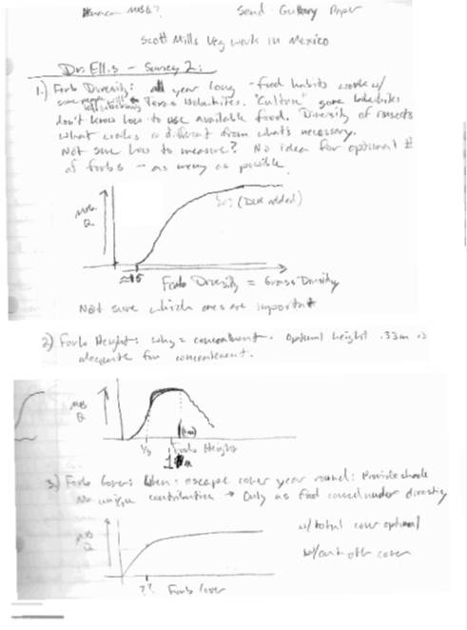
Creating Suitability Indices for Measured Variables
Forb Diversity*
Forb Height*
*Drawings from Dave Ellis
Notes:
Mention Dave

Slide 20
Suitability Equations
Reproduction = Forb Cover + Grass Diversity + Grass Cover + Tree Cover + Structural Diversity + Bare Ground
Food = Forb Diversity + Forb Height * Forb Cover + Shrub Cover + Grass Diversity + Structural Diversity + Woodland-Grassland Edges + Leaf Litter
Thermal Refuge = Tree Cover + Leaf Litter
Predator Protection = Forb Height * Forb Cover + Brush Piles + Shrub Cover * Shrub Height + Grass Diversity + Grass Cover * Grass Height + Tree Cover + Structural Diversity + Woodland Grassland Edges + Bare Ground
Measurable Variable
Measured Variable 1
Critical Habitat Component 1
Critical Habitat Component 2
Measured Variable 2
Critical Habitat Component 3
Habitat Suitability Index

Slide 21
Suitability Equations: Additive or Interaction Terms?
Food = Forb Diversity + Forb Height * Forb Cover + Shrub Cover + Grass Diversity + Structural Diversity + Woodland-Grassland Edges + Leaf Litter
(+) -> If variables can compensate for each other then the relationship is additive.
(*) -> If variables depend on each other then the relationship is interactive
In this example the “Forb Cover” must be at the correct “Forb Height” in order to be suitable

Slide 22
Suitability Equations
Scores from each critical habitat function are combined to give an overall habitat suitability score
Measurable Variable
Measured Variable 1
Critical Habitat Component 1
Critical Habitat Component 2
Measured Variable 2
Critical Habitat Component 3
Habitat Suitability Index

Slide 23
Suitability Pathways
Reproduction
Food
Thermal Ref.
Predator Protection
Habitat Suitability
Equation: Reproduction * Food * Thermal Refugia * Predator Protection
Notes:
Each Critical component is directly related to suitability and the relationship is interactive so that each variable is critical and if any score is 0 the whole model is 0.

Slide 24
Suitability Pathways
Reproduction
Food
Thermal Ref.
Predator Protection
Habitat Suitability
If the score of any of these critical components is 0 then the entire model is also 0.
Equation: Reproduction * Food * Thermal Refugia * Predator Protection

Slide 25
Progress to Date
Completed individual HSI models for each expert who agreed to participate (6 HSI models)
Completed separate HSI model based solely on published literature
Estimated uncertainty associated with each suitability relationship
Notes:
Consensus models- Might be helpful to bring experts together to vet these models.
Field testing- Do areas which BANWR consider best for MBQ achieve high suitability scores? Are areas in Mexico where MBQs were last seen optimal?

Slide 26
Understanding Uncertainty
Understanding the uncertainty is important for making management decisions
How much uncertainty is associated with each suitability estimate
What is the source of the uncertainty?
What is the impact of the uncertainty on recovery?
How can we reduce the uncertainty?

Slide 27
Understanding Uncertainty
Potential sources of uncertainty:
Variable selection uncertainty
The nature of the suitability functions
The structure of the model
Relationships between variables
Importance of variables relative to one another
Latent variables (Food, Reproduction, etc.)
Measurement error of model inputs

Slide 28
Understanding Uncertainty
Potential sources of uncertainty:
Variable selection uncertainty
The nature of the suitability functions
The structure of the model
Relationships between variables
Importance of variables relative to one another
Latent variables (Food, Reproduction, etc.)
Measurement error of model inputs

Slide 29
Understanding Uncertainty
Potential sources of uncertainty:
Variable selection uncertainty
The nature of the suitability functions
The structure of the model
Relationships between variables
Importance of variables relative to one another
Latent variables (Food, Reproduction, etc.)
Measurement error of model inputs

Slide 30
Estimating Uncertainty
Uncertainty of Suitability Relationships:
We used the complete set of expert opinion to quantify uncertainty for each suitability function
Assumes the “true” relationship is spanned by the set of expert opinions
Assumes experts at the extreme range of the function are either over or underestimating the true relationship
Provides a tool for understanding where experts agree or disagree

Slide 31
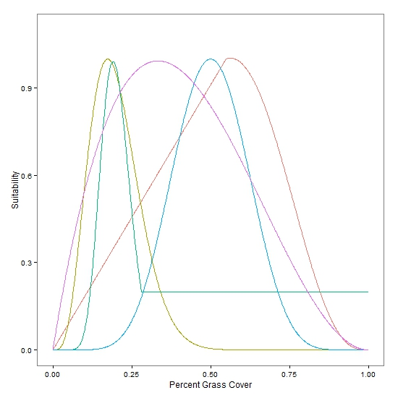
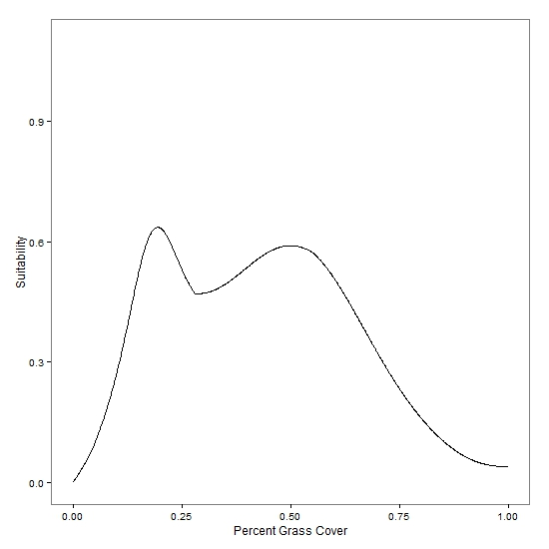
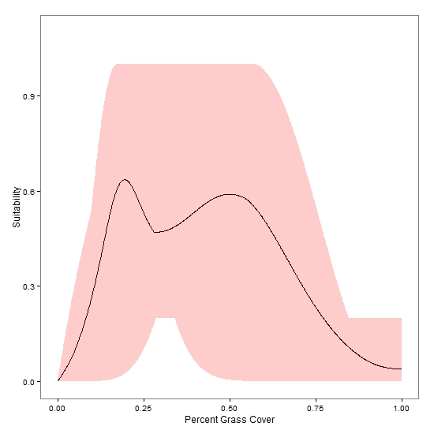
An Example
Uncertainty of Proportion Grass Cover
Diversity of Opinions
Average Suitability
Uncertainty

Slide 32
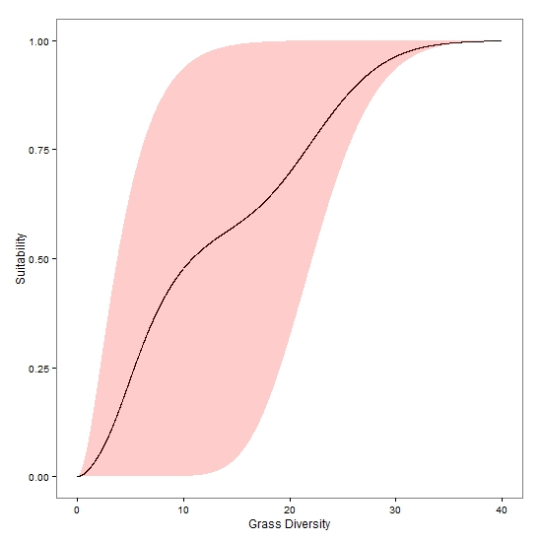
Another Example
Uncertainty of Grass Diversity
Diversity of Opinions
Average Suitability
Uncertainty

Slide 33
What does this tell us?
There is no consensus on the best amount of grass cover

Slide 34
What does this tell us?
There is no consensus on the best amount of grass cover
The mean is bi-modal

Slide 35
What does this tell us?
There is no consensus on the best amount of grass cover
The mean is bi-modal
There is a large amount of uncertainty

Slide 36
What does this tell us?
There is no consensus on the best amount of grass cover
The mean is bi-modal
There is a large amount of uncertainty
There is consensus on an optimal number of grass species

Slide 37
What does this tell us?
There is no consensus on the best amount of grass cover
The mean is bi-modal
There is a large amount of uncertainty
There is consensus on an optimal number of grass species
The mean is consistent, i.e. one can compare two sites to see which is better

Slide 38
What does this tell us?
There is no consensus on the best amount of grass cover
The mean is bi-modal
There is a large amount of uncertainty
There is consensus on an optimal number of grass species
The mean is consistent
There is a less uncertainty

Slide 39
What does this tell us?
We can compare uncertainty between variables by numerically integrating the area of the uncertainty estimate
Three steps:
Standardize the units among variables
Integrate
Rank Variables based on uncertainty

Slide 40
Uncertainty of Suitability Functions
Habitat Variable | Uncertainty | Habitat Variable | Uncertainty
Forb Diversity | 751.4589 | Annual Grass Diversity, MX | 549.9952
Shrub Cover: MX, Summer | 681.4633 | Annual Grass Diversity, AZ | 549.8661
Shrub Cover: MX, Winter | 681.4633 | Forb Height in the Spring | 530.6362
Forb Height in the Fall | 680.5916 | Tree Cover: MX, Arroyos, Summer | 527.6743
Shrub Cover: AZ, Summer | 669.5275 | Perennial Grass Diversity, MX | 527.2701
Tree Cover: MX, Uplands, Winter | 649.679 | Perennial Grass Diversity, AZ | 524.865
Shrub Cover: AZ, Winter | 635.0047 | Tree Cover: MX, Uplands, Summer | 523.689
Tree Cover: AZ, Arroyos, Winter | 632.0208 | Tree Cover: AZ, Arroyos, Summer | 522.2229
Tree Cover: AZ, Uplands, Winter | 603.743 | Grass Height for Nesting | 511.7814
Perennial Grass Cover, MX | 602.9204 | Forb Cover: AZ, Winter | 500.3264
Annual Grass Cover, MX | 601.5158 | Tree Cover: AZ, Uplands, Summer | 480.8542
Annual Grass Cover, AZ | 592.9706 | Forb Cover: MX, Winter | 466.7073
Perennial Grass Cover, AZ | 587.2909 | Forb Cover: MX, Summer | 425.4503
Tree Cover: MX, Arroyos, Winter | 586.0451 | Shrub Height | 127.2489
Grass Height for Cover | 557.5849 | Proportion of Bare Ground | 125.2965
Forb Cover: AZ, Summer | 552.1541

Slide 41
Future Work
Determining uncertainty associated with entire model
Field testing the models (with Steve Sesnie and Lacrecia Johnson)
How well do they discriminate between habitats?
How different are they from each other when scoring particular areas?
What can be done to improve the method?
Notes:
Send an email with presentation and specific questions for the recovery team. What scale to apply the model? What other information to include? Ask Courtney whether he wants to extend the project?

Slide 42
Questions and Feedback?

